Slide 1
Introduction to WordPress
Adrian Sanabria-Diaz & David Hayes

Slide 2
Introduction
Understanding Wordpress
Non-Profit Organizations using WordPress
The Power of Open Source
Collaboration Customization
Theme Selection
Plugins and Functionality
Content Management, Blogging, and SEO
Donations, Memberships, Subscriptions
Event Management and Volunteer Engagement
Communication, Campaigns and Outreach
Wordpress in Action (Demo)
Real-World Success Stories
Best Practices and Tips
Disclaimer: Installing Wordpress requires some Technical Know-How
Q&A and Conclusion

Slide 3
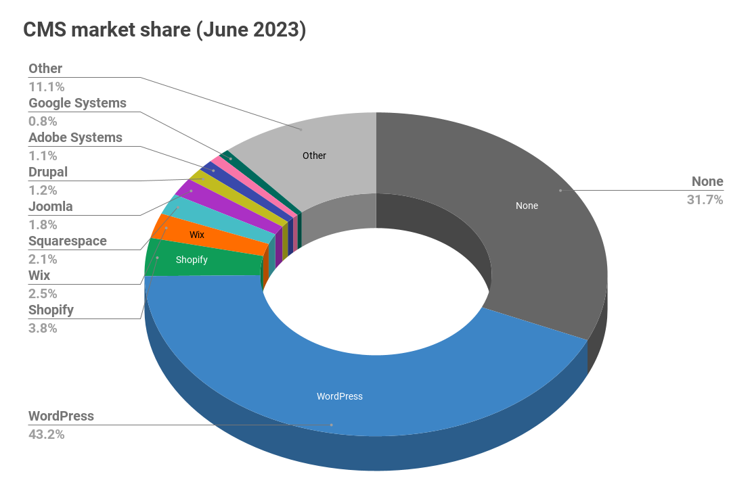
Understanding WordPress
WordPress is an open-source content management system (CMS) for websites.
Used by small and big business and non-profit organizations.
Market Dominance of 43% of all websites (June 2023)
Easier to get off the ground then a website from scratch
Plugins allow many organizations the ability to deploy little to no code
Flexibility for diverse website types and complexities
https://www.searchenginejournal.com/wordpress-dominates-market-share-of-top-10000-websites/415113/

Slide 4
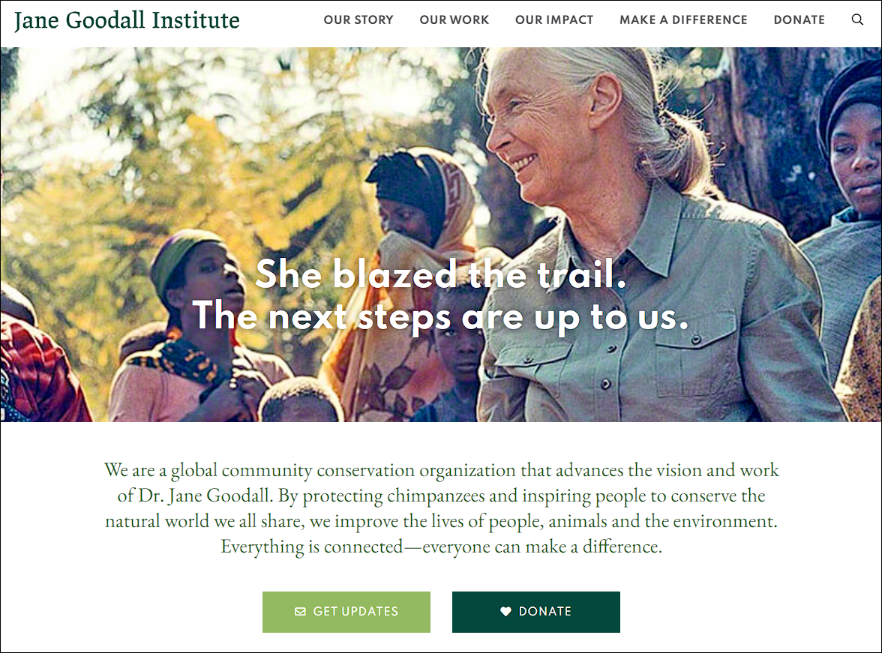
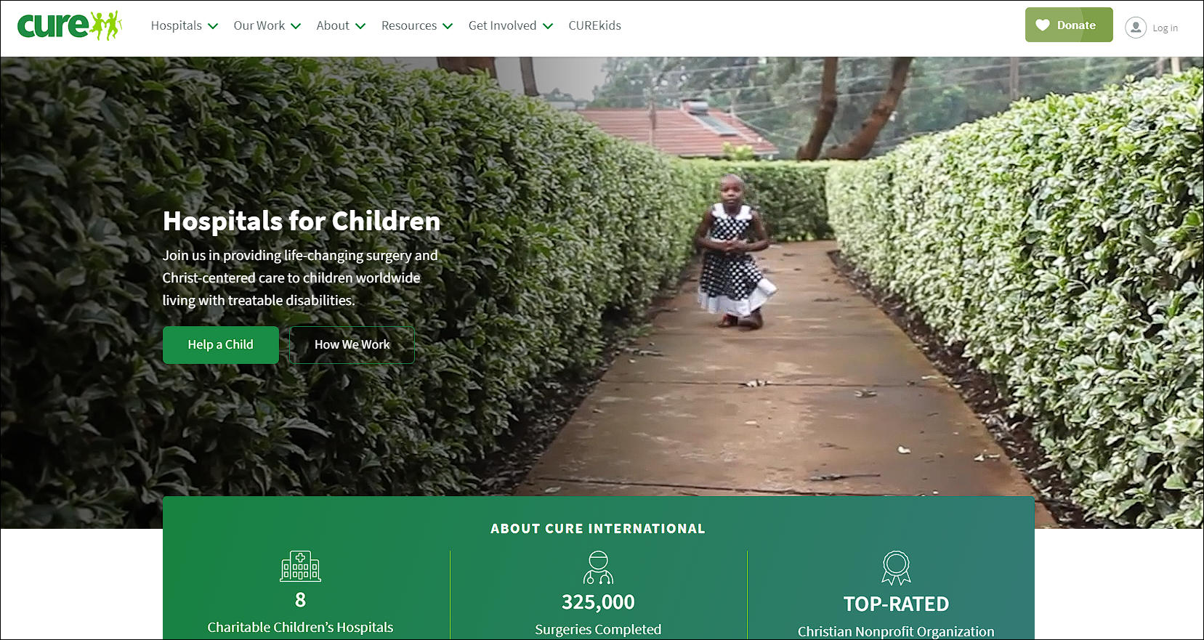
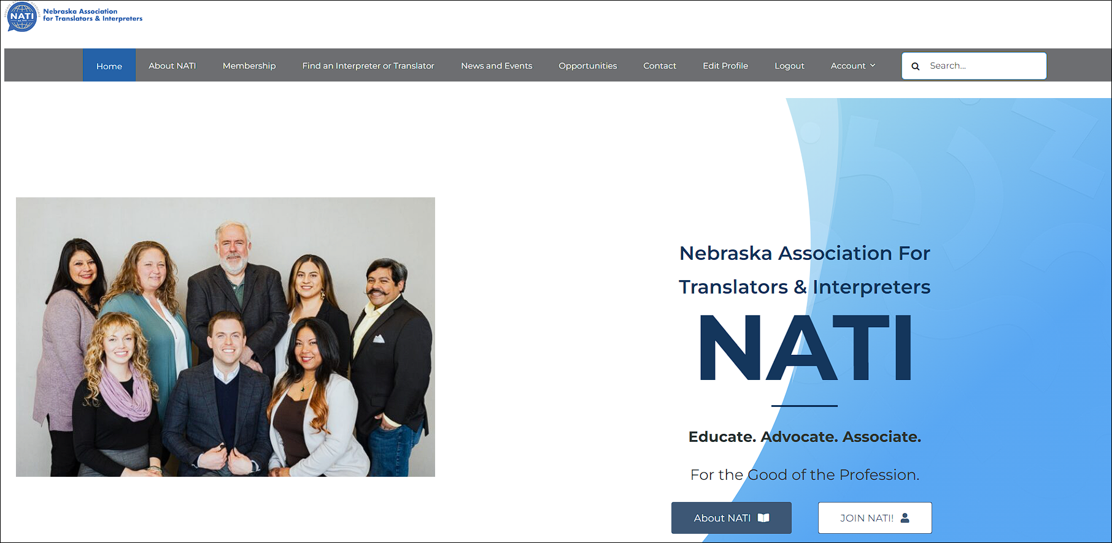
Non-Profit Organizations Using WordPress
The Jane Goodall Institute
Works to protect chimpanzees and other animals.
Team Rubicon
Provides disaster relief services.
CURE International
Provides medical care for children with disabilities.
The Big Give
Helps donors find charities to support.
The Interfaith Housing Alliance
Provides affordable housing.
Peoples Under Threat
Works to protect people from genocide.L
Los Angeles LGBT Center
Works to build a world where LGBTQ+ people thrive as healthy, equal, and complete members of society.
Nebraska Association for Translators and Interpreters (NATI)
NATI provides industry resources and training for hundreds of translation and interpretation professionals.

Slide 5
The Power of Open Source
Open source software is software with source code that anyone can inspect, modify, and enhance.
"Source code" is the part of software that most computer users don't ever see; it's the code computer programmers can manipulate to change how a piece of software—a "program" or "application"—works.
Programmers who have access to a computer program's source code can improve that program by adding features to it or fixing parts that don't always work correctly.

Slide 6
Collaboration and Customization
Open Source allows for strong collaboration
Customization through Themes and Plugins (highlighted later in the presentation)
Don’t reinvent the wheel! Look for plugins
Massive online community if you encounter any issues with most of your questions likely already answered by many others

Slide 7
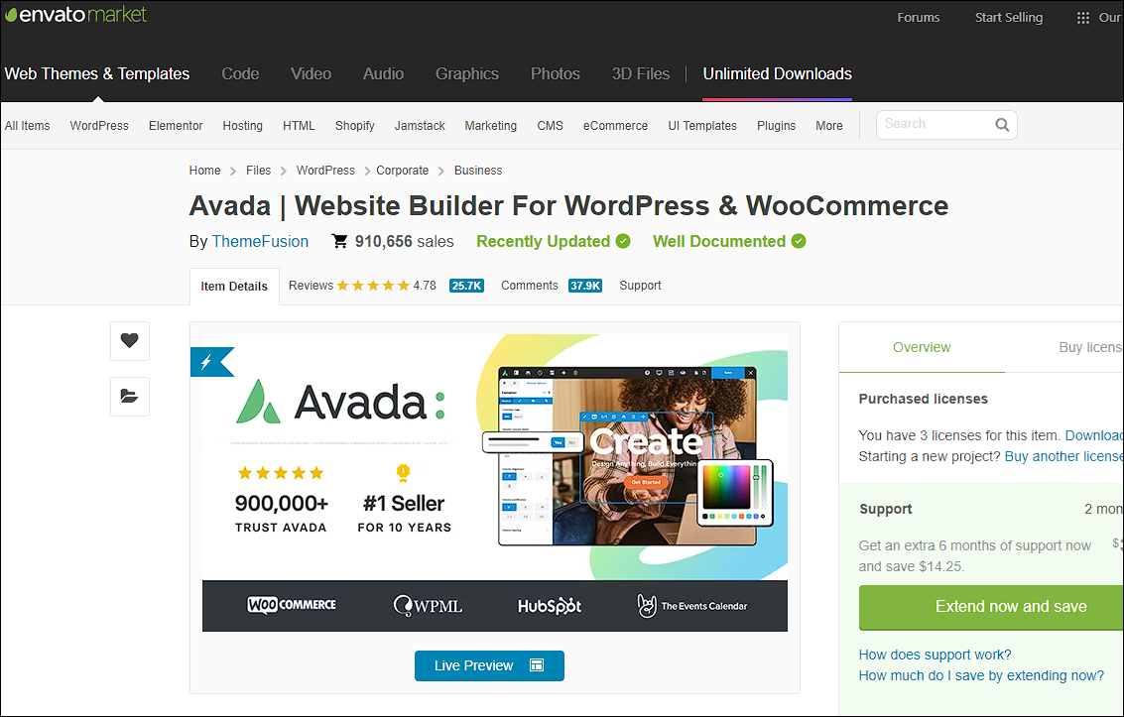
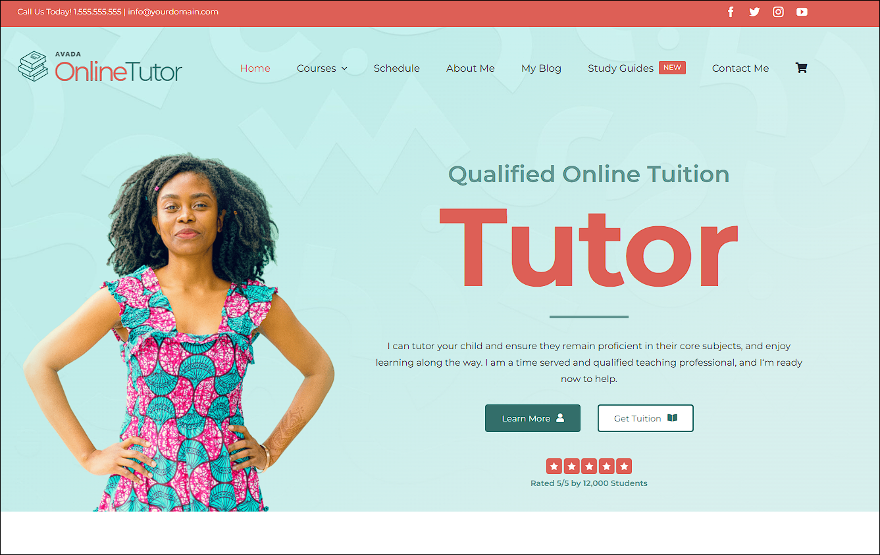
Themes Selection
Making a website representative of your brand, company, or non-profit relies heavily on the look and feel of that website.
Most Themes available for Free or priced between $10 - $150 depending on complexity
Bulk of the work comes from making the website your own and plugin integration
Some themes include their own forms and design style

Slide 8
Plugins and Functionality
A WordPress plugin is a piece of software that can be added to your WordPress website to extend its functionality and add new features.
Designed to Integrate seamlessly with WordPress
Used to customize and enhance the capabilities of your website without requiring extensive coding knowledge.
Offer a wide range of functionalities, such as
adding contact forms
social media sharing buttons
e-commerce features
search engine optimization tools
security enhancements
performance optimization
analytics integration, and much more.
Allow you to add specific features or functionalities to your website without having to build them from scratch.

Slide 9
Content Management, Blogging, and SEO
Wordpress was created when the internet was mainly used for blogging. Since then, the internet has grown and evolved into what it is today and Wordpress evolved with it and today is used by eCommerce companies, non-profits, businesses, and everything in between.
Content management systems work to help you do just that. Manage your content. Without needing to know how to code, you can easily add pages, blog pages / posts, upload images, and change text on your website.
This is where SEO comes in. SEO, or Search Engine Optimization, is like giving your blog a special map that helps search engines understand what your blog is about. With the help of plugins, which are like little helpers for your blog, you can add information to your blog posts that tells search engines, "Hey, this blog post is really useful and relevant to what people are looking for!"

Slide 10
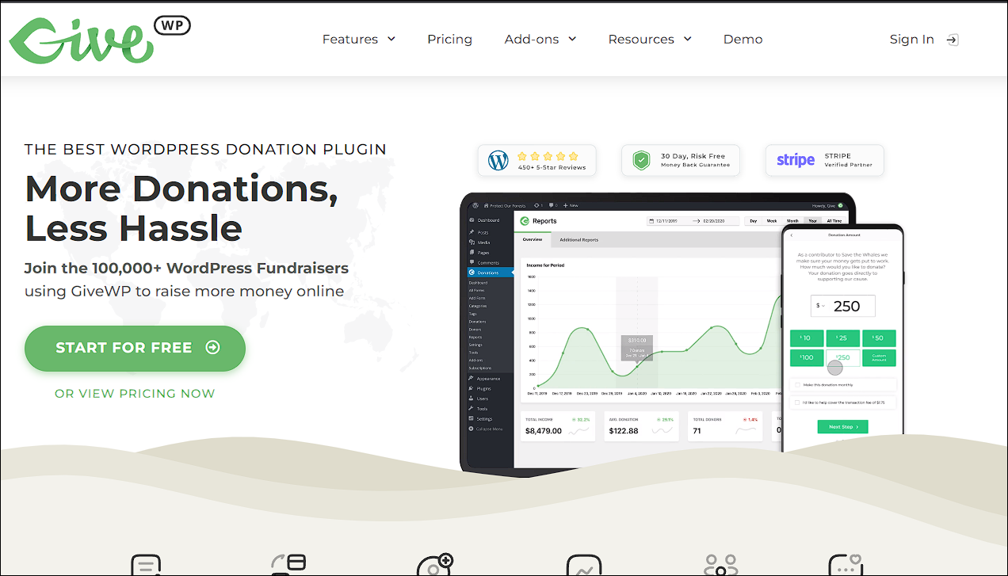
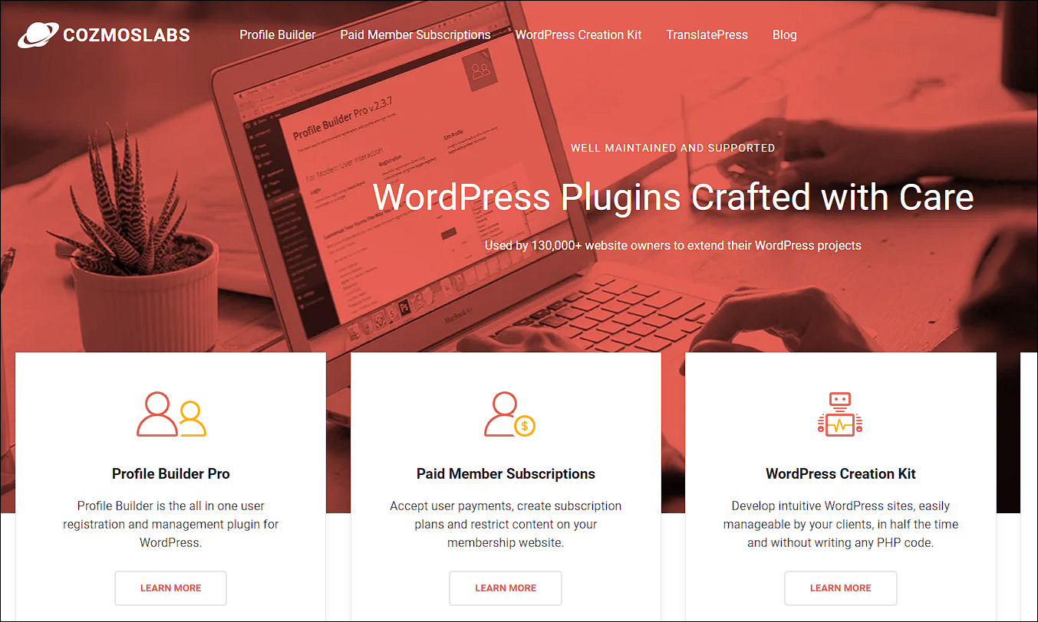
Donations, Memberships, Subscriptions via Plugins
Examples of Plugins that meet workflows for Donations, Memberships and Subscriptions
Donations
WPForms
GiveWP
https://donate.lalgbtcenter.org/
https://natihq.org/donate/
Charitable
PayPal Donations
Donation Thermometer
Memberships / Subscriptions
MemberPress
Restrict Content Pro
Paid Memberships Pro
Ultimate Member
WooCommerce Memberships

Slide 11
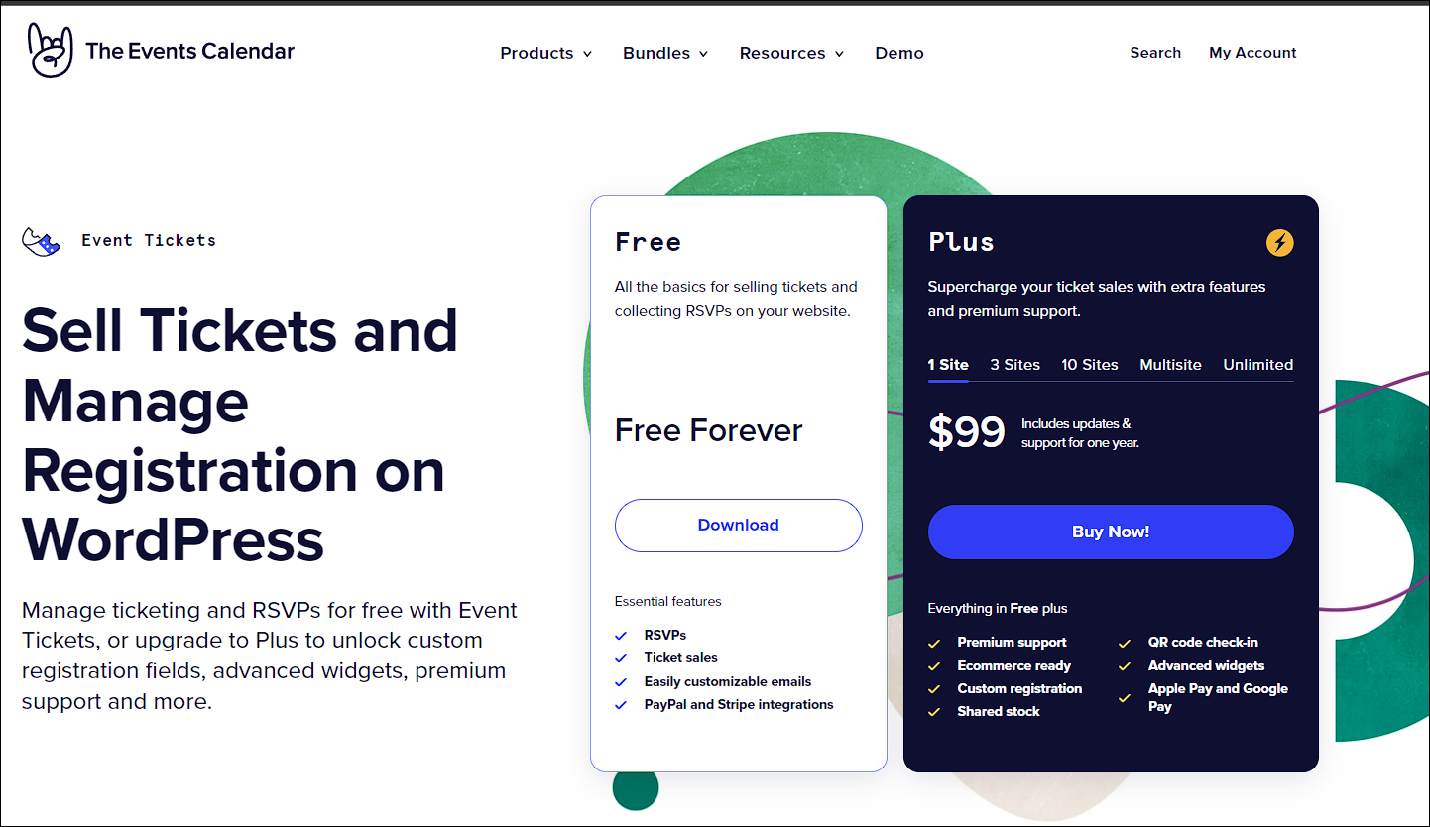
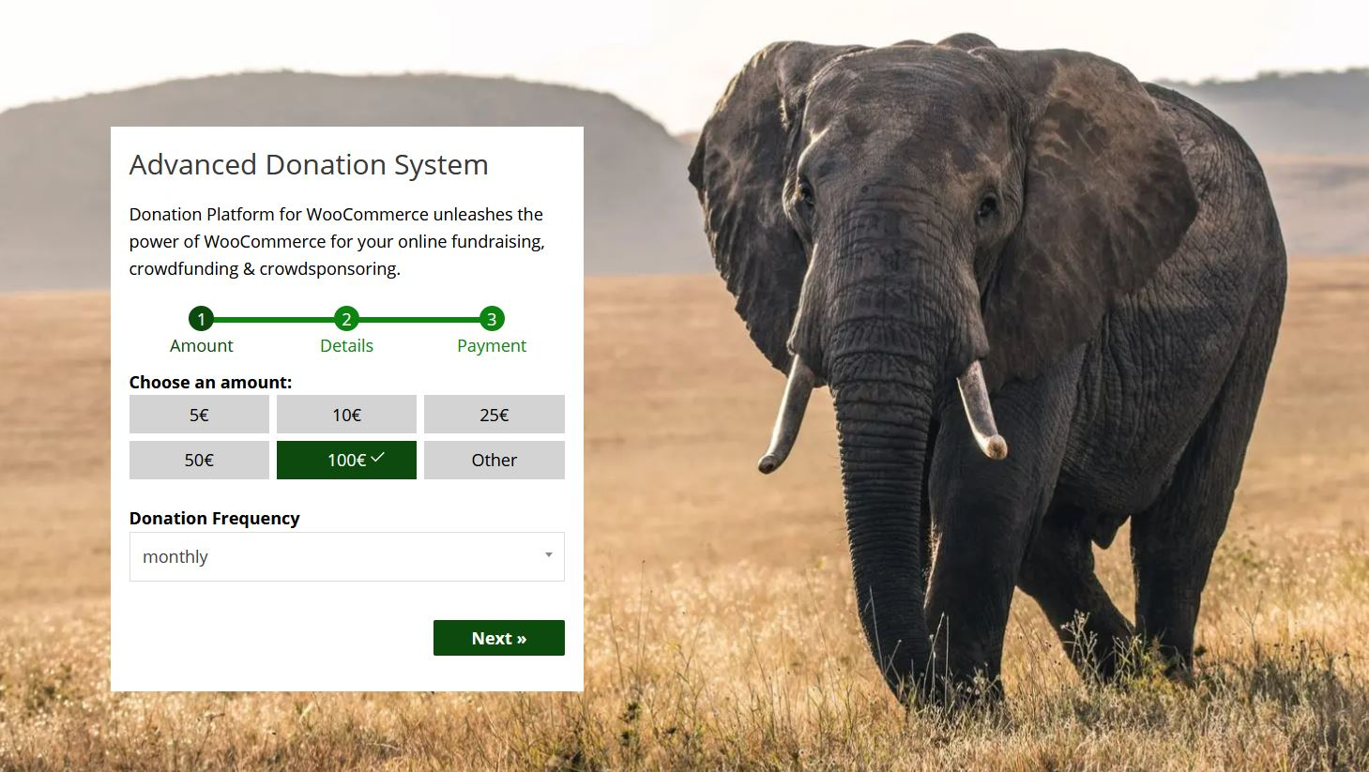
Event Management and Volunteer Engagement
Event Management
Events Manager
WP Event Manager
Event Organiser
Amelia
All-in-One Event Calendar
The Events Calendar
My Calendar
EventOn
Calendarize it! for WordPress
Modern Events Calendar
Stachethemes Event Calendar
Tickera
Volunteer Engagement
Wired Impact Volunteer Management
Participants Database
RSVPMaker Volunteer Roles

Slide 12
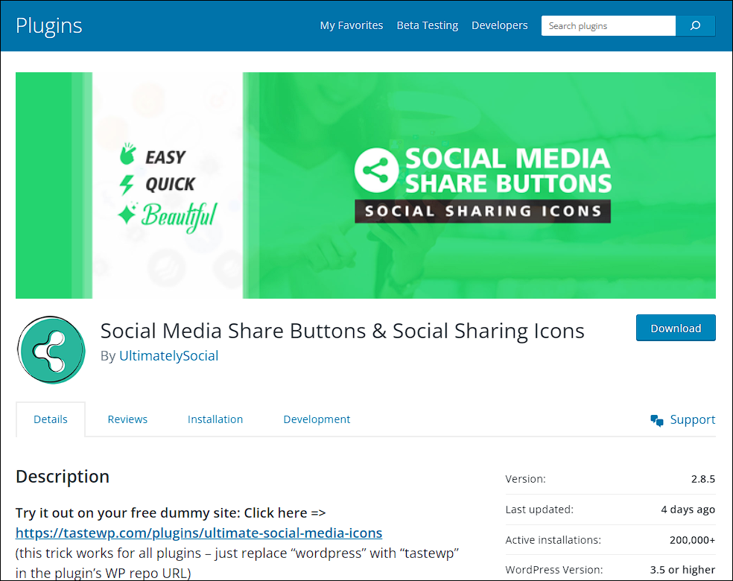
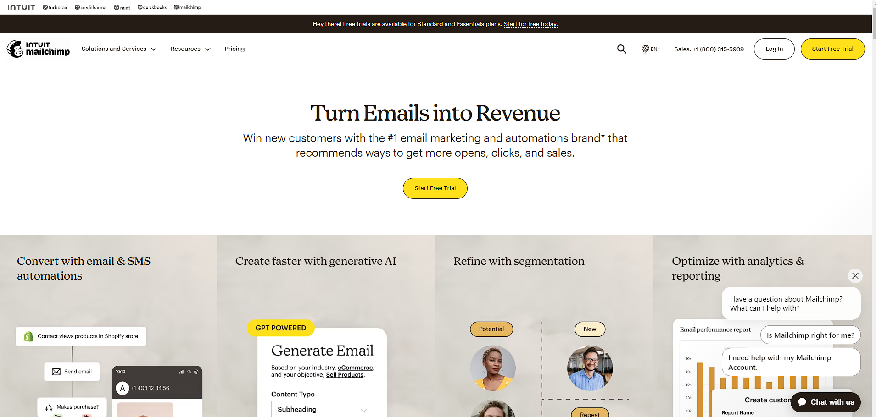
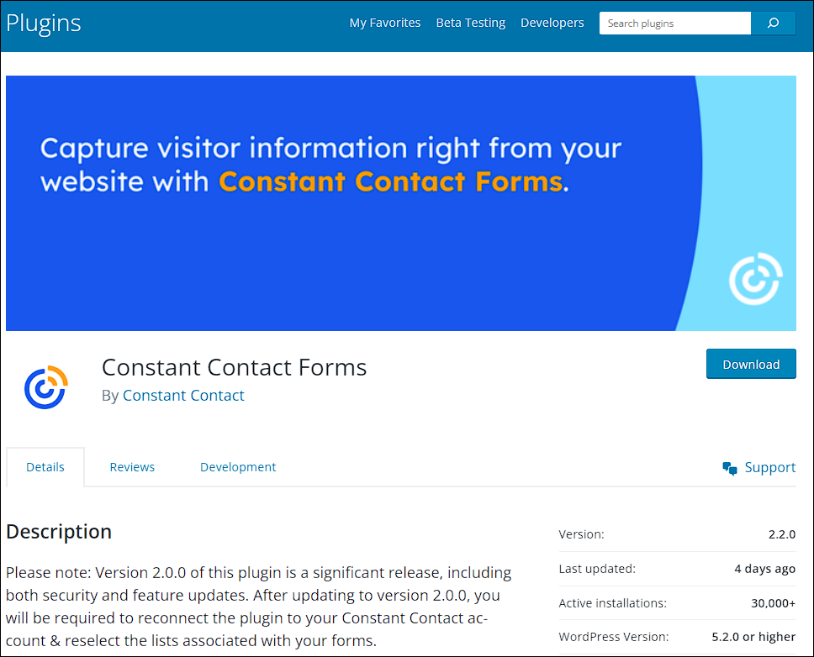
Communication, Campaigns and Outreach
Effective communication is key for nonprofits to engage supporters, donors, and the community. This workflow includes creating and sending newsletters, email campaigns, and social media updates. Email marketing and social media management tools can be useful here.
Powerful tools include:
MailChimp
Constant Contact for WordPress
Social Media Share Buttons & Social Sharing Icons

Slide 13
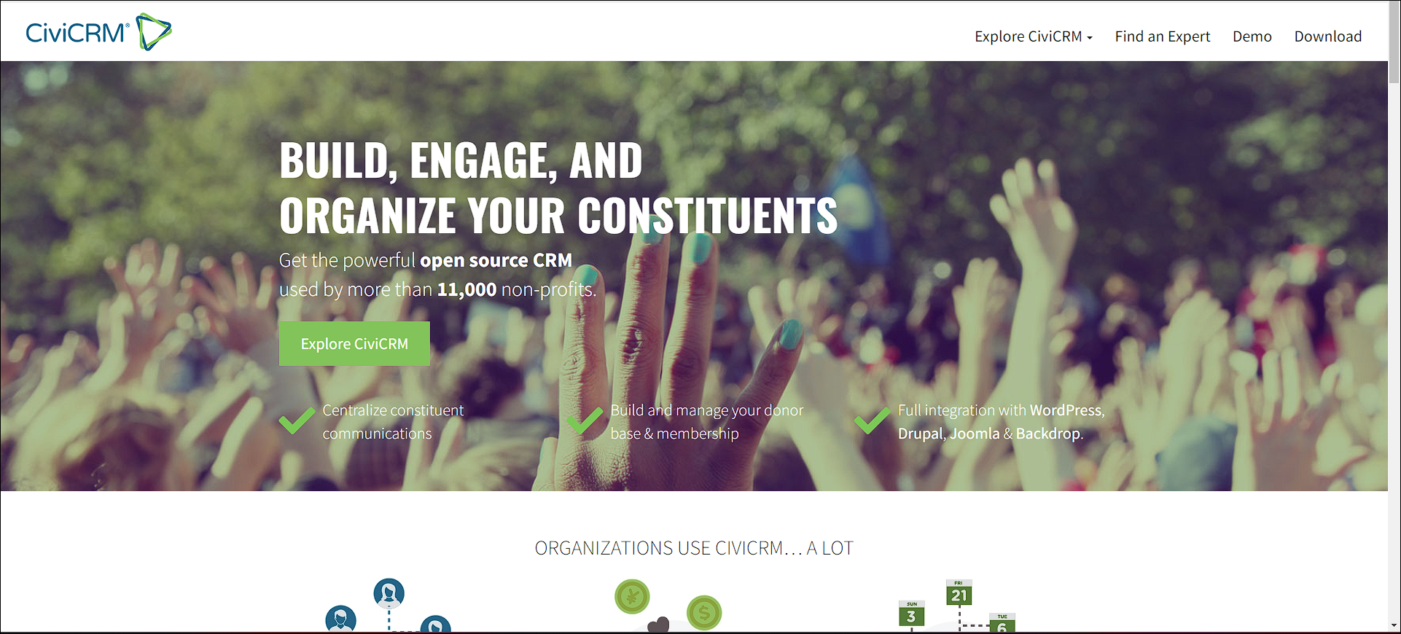
CiviCRM
Contact Management: Automatically store all data for each contact in one place, creating a unified, holistic record for each constituent.
Configurable & Customizable: CiviCRM’s open-source license will allow you the freedom to find the right programmer to tailor your installation specifically to your needs.
Membership Management: Individuals can sign up and pay for their membership online, receive automatic membership renewal reminders, and receive member-only emails.
Accounting Integration: Enter your gifts once in CiviCRM, and export them in the accounting format that your accounting system - and your accountant - will love.
Case Management: CiviCRM allows organizations to create, manage, and track simple or sophisticated case management workflows.
Event Management: CiviCRM provides a full set of tools for running events and recording a constituent’s attendance in their activity record.
Email Marketing: Create and manage bulk email lists. You can also segment your lists, do A/B testing, and monitor statistics.
Contribution Management: Process and track contributions, send gift acknowledgments, and report on your data in an elegant and intuitive workflow process.
Advocacy Campaigns: Build advocacy campaigns by tying together and tracking the progress of a campaign’s events, mailings, activities, and contributions.
Peer-to-Peer Fundraising: Your members and donors can raise funds on behalf of your organization through personal campaigns.
Reports: Choose one of the 40 standard reports or configure and create a custom report to evaluate your organization’s impact.
CiviCRM is a powerful, web-based constituent relationship management (CRM) system built by and for nonprofit organizations and NGO's. One could also use this application in place of the several plugins used.

Slide 14
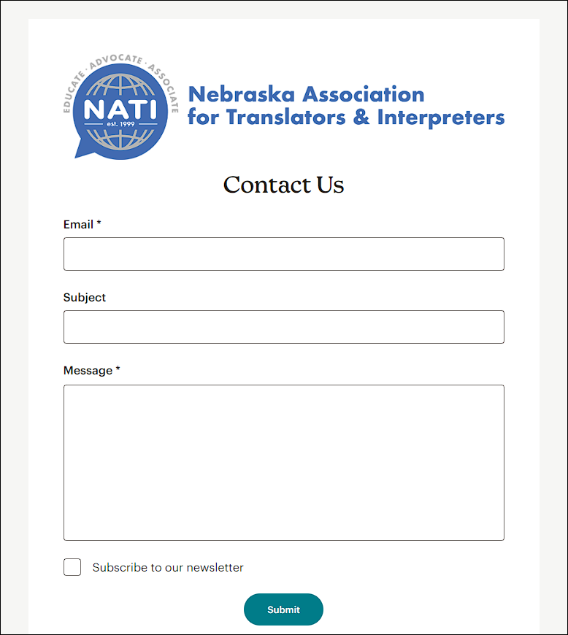
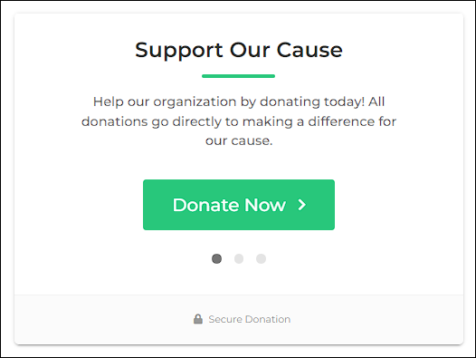
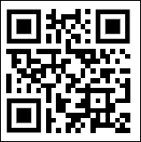
Real-World Success Stories
https://natihq.org or hover over the QR code
NATI’s Joomla to Wordpress Migration
Case study
Challenges, Solutions, and Outcomes and why the switch to Wordpress
NATI had the following requirements
Donation Page
Event Management and Ticketing
Membership Management
Ability to Search through Interpreters and Translators
Contact Form pages
Campaign Management

Slide 15
Best Practices and Tips
Keep Plugins Up to Date
Keep server up to date!
Keep images small when uploading
Analytics to measure engagement (e.g. MailChimp, Google SiteKit, Monster Insights)
Use a Trusted CDN (e.g. CloudFlare)
We recommend the Wordfence Plugin for security

Slide 16
Disclaimer: Installing Wordpress requires some Technical Know-How
Wordpress has a product that allows you to use their servers to run your blog, however, for more complex workflows, like NATI uses, you will need to host this on your own server.
This is where you can contact either Adrian Sanabria-Diaz with Tiempo LLC or David Hayes with BlackBrick Software in setting Wordpress up for you.

Slide 17
Disclaimer: Installing Wordpress requires some Technical Know-How
Once WordPress is running on a server, you can start updating the content on that website. We can help with recommending plugins, keeping the server up to date, and converting any workflows you have and integrating them with WordPress.

Slide 18
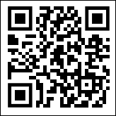
Q&A and Conclusion
Thank you!
Contact Information:
adrian@tiempo.llc, david@blackbrick.software

